Slide 1
CourseKey Student Orientation
Notes:
SLIDE 1: As some of you have seen in the syllabus, we will be using CourseKey as an attendance and engagement tool for this classroom. I’ll be briefly exp­­­­­­­­­laining how everyone can get set-up and registered, but please always direct any technical questions to the CourseKey support team.
IMPORTANT TO REMEMBER: CourseKey has a live chat Monday through Friday, 9:00 am to 5:00 pm PST and you can talk to an agent immediately with any questions regarding payment, subscription options, or any technical issues.

Slide 2
To Sign-Up:
or
Go to
Search for “CourseKey” and download the app
Click “sign up”
Input your information
NOTE: your “School-Issued ID” is your student ID
Notes:
SLIDE 2: This slide is a step-by-step process on how you can register your account with CourseKey if you’ve never used CourseKey before. It’s highly recommended that you download the student app through Google Play (Android) or iOS app stores. If you don’t have an Android or iPhone, you may use a tablet, laptop, or even the web browser on your phone (IMPORTANT: YOU MUST USE THE CHROME BROWSER!). When registering your account, please make sure that you input the correct Student ID.

Slide 3
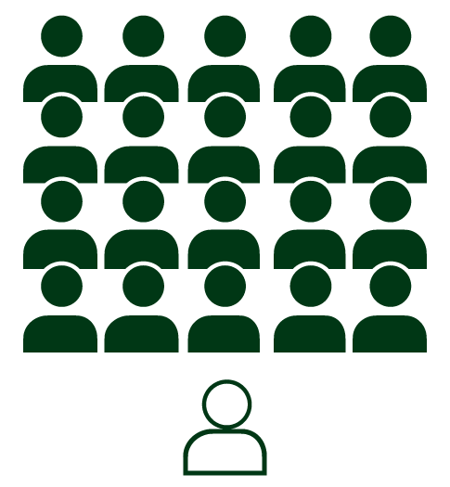
How to add this class:
Add this class with the join code provided by your instructor in your syllabus
OR by searching for your Professor’s name
And don’t forget to upload your picture!
Notes:
SLIDE 3: After creating your new account, it’s time to add this class. Use the join code to add our class that was provided in the syllabus. Please don’t get the JOIN CODE mixed up with your Student ID; the former is meant to get you added in the class and the latter is your Student ID number that you use on an everyday basis on campus for identifying yourself.

Slide 4
CourseKey Overview:
Attendance
Assessments
Grades
Ask the Professor
Chat
SUPPORT:
Live chat M-F 9:00 am - 5:00 pm PST
Email
CourseKey Help Center
Notes:
SLIDE 4: Now that you’ve created your account and successfully added our class, I’m going to highlight how we’ll be using CourseKey for this class and how to make the most out of it for your own learning benefit.
Attendance – we’ll be taking attendance through CourseKey; every class day, please go into your app or the CourseKey portal and click on the Attendance button. Please make sure you have a fully charged device (cell phone, laptop, tablet) during class so that you can successfully participate in class. Please also make sure you arrive on time and get into the habit of coming into class and checking in with CourseKey as you’re responsible for your attendance. I’d advise using the CourseKey attendance as a way to keep a “paper trail” of your participation for the end of the term.
Assessments – we’ll be doing quizzes, polls, and assessments via CourseKey. These questions can be multiple choice, short-response, matching, etc. We’ll be using this for knowledge retention and to keep us engaged throughout the term. Please verify that all assessments questions are saved at the end of an assessment by clicking on ‘Submit Assessment’ (it’s also important to verify that you have internet connection/Wi-Fi when answering these questions).
Grades – immediately after you’ve checked in for your attendance, your attendance records will be accessible under grades. Similarly, immediately after an assessment is completed, you’ll be able to check your scores as well as the entire quiz under ‘grades’. Use this tool as an on-going STUDY GUIDE for yourself and to keep track of your learning.
Ask the Professor – you may use this tool to ask questions to your instructor in real-time during class. These questions will be anonymous to your classmates and we can use this to start discussions and to focus on some of the areas you’re struggling with. All your questions will be recorded, and I also recommend using this as a paper trail of your participation and as a way to keep record of the high level of questions and participation you’re partaking during class.
Chat – everyone in this class (including your instructor) has access to a 24/7 chat in CourseKey. It’s advised that you download the app so that you get notifications from the chat and get in touch with your classmates about readings, class material, or any questions you may have inside or outside of class. Use the chat as an academic tool to better your learning experience and network with your classmates. I expect politeness and respect from everyone.
SUPPORT – please direct ALL questions to the CourseKey support team. As your instructor, I’m not a customer service agent for CourseKey. As I mentioned earlier, CourseKey has a live chat Monday through Friday, 9:00 am to 5:00 pm PST. If you’d like to reach them outside of these hours, you can email them at support@coursekeyeducation.com or send them a message directly through the CourseKey app under the ‘support’ button.
HELPFUL LINKS:
https://support.coursekeyeducation.com

Slide 5
Questions?
Notes:
SLIDE 5: I wanted to reiterate that any questions you may have you should contact the CourseKey support team. They have email (support@coursekeyeducation.com), live-chat, and a message system through the app itself.­

